Slide 1
UNIT-II
1.Covering Rules(Rule Based Classification)
2.Bayesian Networks
3.Linear Models

Slide 2
Rule-based Classification in Data Mining
Rule-based classification in data mining is a technique in which class decisions are taken based on various “if...then… else” rules. Thus, we define it as a classification type governed by a set of IF-THEN rules. We write an IF-THEN rule as:
“IF condition THEN conclusion.”
IF-THEN Rule
To define the IF-THEN rule, we can split it into two parts:
  Rule Antecedent: This is the “if condition” part of the rule. This part is present in the LHS(Left Hand Side). The antecedent can have one or more attributes as conditions, with logic AND/OR operator.
  Rule Consequent: This is present in the rule's RHS(Right Hand Side). The rule consequent consists of the class prediction.
Example:
R1: IF tutor = codingNinja AND student = yes Antecedent
THEN happyLearning = true Consequent

Slide 3
Assessment of Rule
In rule-based classification in data mining, there are two factors based on which we can access the rules. These are:
Coverage of Rule: The fraction of the records which satisfy the antecedent conditions of a particular rule is called the coverage of that rule.
We can calculate this by dividing the number of records satisfying the rule(n1) by the total number of records(n).
Coverage(R) = n1/n
Accuracy of a rule: The fraction of the records that satisfy the antecedent conditions and meet the consequent values of a rule is called the accuracy of that rule.
We can calculate this by dividing the number of records satisfying the consequent values(n2) by the number of records satisfying the rule(n1).
Accuracy(R) = n2/n1
Generally, we convert them into percentages by multiplying them by 100.

Slide 4
Properties of Rule-Based Classifiers
There are two significant properties of rule-based classification in data mining. They are:
    Rules may not be mutually exclusive
    Rules may not be exhaustive

Slide 5
Rules may not be mutually exclusive in nature
In rule-based classification, we create IF-THEN rules to assign classes to data.
Mutually exclusive means that only one rule applies to a given instance.
But in reality, multiple rules can apply to the same instance (they overlap).
That’s why rules may not be mutually exclusive in nature.
When rules overlap, the classifier needs a conflict resolution strategy, such as:
  Rule priority (order of rules)
  Specificity (more specific rules preferred)
  Rule confidence (probability-based choice)

Slide 6
Example (Student Performance Classification)
Suppose we want to classify whether a student is High Performer or Average Performer.
Rule 1:
IF attendance > 80% AND assignments = completed
THEN class = High Performer
Rule 2:
IF test_score > 70%
THEN class = High Performer
Rule 3:
IF attendance < 60%
THEN class = Average Performer
Now consider a student:
attendance = 85%
assignments = completed
test_score = 75%
✅ This student satisfies Rule 1 and Rule 2 → both classify the student as High Performer.
👉 Multiple rules applied at once → not mutually exclusive.

Slide 7
Rules may not be exhaustive in nature
In rule-based classification, the learned rules may not cover every possible instance in the dataset.
Some examples may not satisfy any rule.
This is why rules are called non-exhaustive.
Now consider a student:
attendance = 65%
assignments = not completed
test_score = 60%
👉 This student does not satisfy Rule 1, Rule 2, or Rule 3.
Rule 1 fails (attendance not > 80%).
Rule 2 fails (test_score not > 70%).
Rule 3 fails (attendance not < 60%).
✅ So, this student is not classified by any rule.

Slide 8
Implementation of Rule-Based Classifier
We have two different kinds of methods for implementing rule-based classification in data mining. They are:
    Direct Method
    Indirect Method

Slide 9
Direct Method
The direct method for rule-based classification in data mining contains algorithms that extract rules directly from the dataset.
The prominent among these are:
    1R Algorithm
    Sequential Covering Algorithm

Slide 10
1R Algorithm
The 1R Algorithm is also known as the Learn One Rule Algorithm. It is based on a simple classification rule. Thus it is one of the simplest algorithms.
In this algorithm, we make rules to test each attribute. If the attribute has a range of values, we make rules by counting how often each class value appears. We do this to know its frequency and find the class with the maximum frequency. Then we assign that class to the attribute value pair. After this, we calculate the error rate for each attribute and select the one with the lowest error rate.
There can be some problems with the 1R method; there is a high chance of overfitting and noise sensitivity. So, to overcome these problems, we use the Sequential Covering Algorithm.

Slide 11
Sequential Covering Algorithm
The sequential covering algorithm is the most widely used algorithm in rule-based classification in data mining.
This algorithm defines rules to cover the maximum data records of one class and no data records of other classes.
In these algorithms, rules are grown sequentially, one at a time.
After a rule is grown, all data records covered by that rule are eliminated, and then this process keeps on repeating for the rest.
This process will stop when we reach the stopping criteria, i.e., if the accuracy of the rule is below the required level, then we reject that rule and stop there.
    IF Age > 40 THEN Buys_Computer = Yes
    IF Age <= 30 AND Student = Yes THEN Buys_Computer = Yes
    IF Age = 31–40 THEN Buys_Computer = Yes

Slide 12
Indirect Method
In the indirect method of rule-based classification in data mining, we extract rules from different other classification models. Some prominent classifications from which we extract the rules are decision trees and neural networks.
For example:
  Converting the decision tree to the rule set.

Slide 13
Advantages of Rule-Based Classification
The rule-based classification is easy to generate.
It is highly expressive in nature and very easy to understand.
It assists in the classification of new records in significantly less time and very quickly.
It helps us to handle redundant values during classification properly.
The performance of the rule-based classification is comparable to that of a decision tree.

Slide 14
"Bayesian Networks in Data Mining"
"Bayesian Networks in Data Mining" usually refers to the application of Bayesian networks (BNs)—a class of probabilistic graphical models—in discovering patterns, making predictions, and handling uncertainty in data mining tasks.
What is a Bayesian Network?
A Bayesian Network (BN) is a directed acyclic graph (DAG) where:
  Nodes represent random variables (features, outcomes, or latent variables).
  Edges represent probabilistic dependencies between variables.
Each node has a conditional probability distribution (CPD) given its parents.
BNs encode the joint probability distribution of all variables, making them powerful for reasoning under uncertainty.

Slide 15
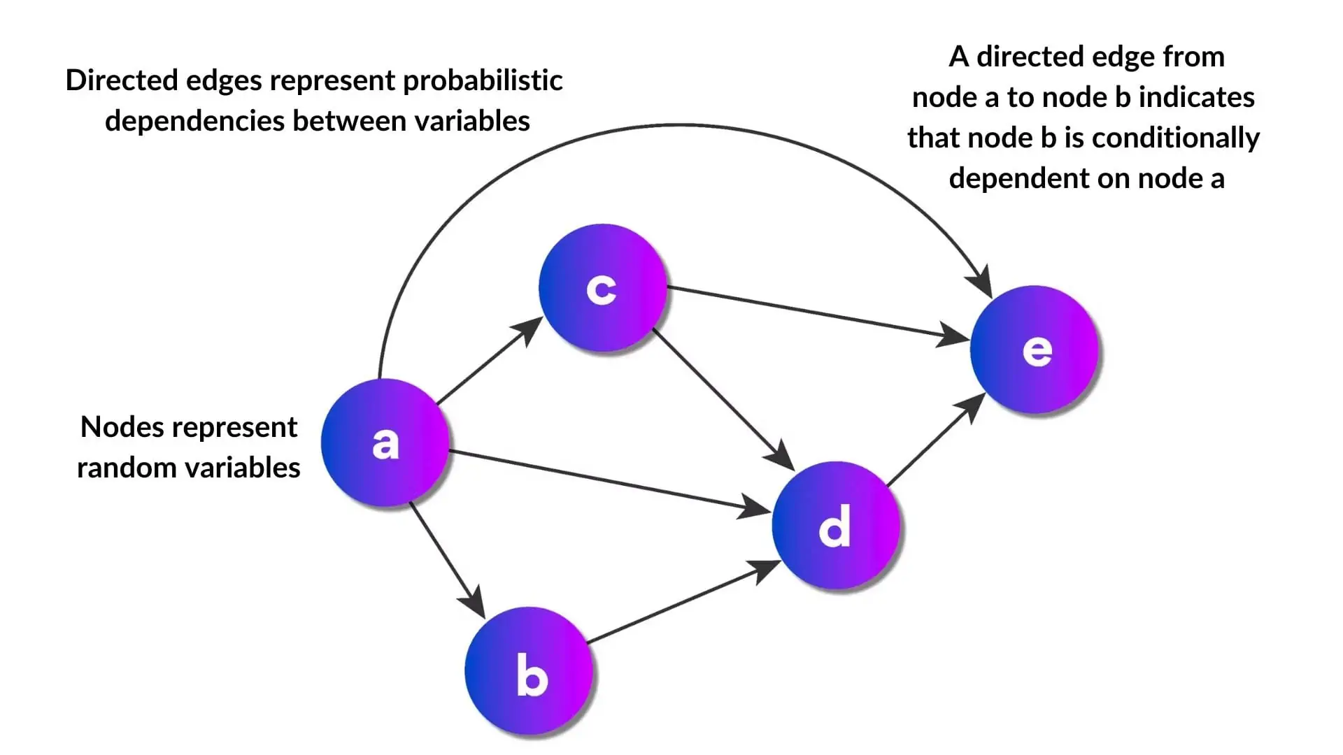
Bayesian Network-Example

Slide 16
Role of Bayesian Networks in Data Mining
Classification & Prediction
  E.g., predicting disease presence, fraud detection, or customer churn.
  Unlike decision trees or neural networks, BNs explicitly model uncertainty and dependencies among features.
Feature Selection & Dimensionality Reduction
  BNs help identify the most relevant features based on probabilistic dependencies.
Clustering & Pattern Discovery
  With extensions like Bayesian belief networks or latent variable models, BNs can uncover hidden structures.
Association & Causal Discovery
  BNs are used to infer causal relationships (not just correlations), valuable in fields like medicine, biology, and economics.
Handling Missing Data
  BNs can perform inference with incomplete datasets, unlike many traditional machine learning models.

Slide 17
Advantages in Data Mining
Probabilistic reasoning: Naturally handles uncertainty and noise in data.
Interpretability: The graphical structure shows clear relationships.
Causality insights: Unlike black-box models, BNs can model causal links.
Flexibility: Can combine domain knowledge with data-driven learning.

Slide 18
Challenges
Structure learning (discovering the DAG from data) is a highly challenging problem due to its computational complexity.
Scalability: Computationally expensive for very large datasets.
Parameter learning requires large amounts of data for accuracy.

Slide 19
Example Applications
Medical diagnosis: Predicting diseases from patient symptoms.
Fraud detection: Modelling dependencies in financial transactions.
Risk management: Estimating probability of failures in engineering systems.
Bioinformatics: Gene regulatory networks and protein interactions.

Slide 20
Linear Models
Linear models are among the most fundamental and widely used approaches in data mining and machine learning.
They model the relationship between a dependent variable (target) and one or more independent variables (features) as a linear combination.

Slide 21
Types of Linear Models
Linear Regression
Logistic Regression
Ridge Regression (L2 Regularization)
Lasso Regression (L1 Regularization)
Elastic Net

Slide 22
Advantages
Simple and easy to implement.
Computationally efficient.
Provides interpretable coefficients.
Works well with large datasets.
Basis for more complex models.

Slide 23
Disadvantages
Cannot capture non-linear relationships (unless features are transformed).
Sensitive to outliers.
Performance degrades with high-dimensional or highly correlated data.
Assumptions may not always hold in real-world data.

Slide 24
Applications in Data Mining
Regression tasks: Price prediction, demand forecasting.
Classification tasks: Customer prediction, medical diagnosis.
Feature selection (via Lasso).
Baseline models before using complex algorithms.

